Slide 1

Beyond the Cure: Modeling the Risk of Breast Cancer Recurrence
Brandon Thomas

Slide 2
Purpose/ Research Question
Purpose
Create a model that allows clinicians to create a personalized treatment plan
Improve patient outcomes and enhance survivorship
Research Question(s)
What variables are most important in predicting breast cancer recurrence?
Can breast cancer be accurately predicted (relative) with the variables included in my dataset?

Slide 3
Data Description
Name | Data Type | Possible Values | Percent Missing Data (% of 286)
Class | Nominal | No-recurrence-events, recurrence-events | 0
Age | Ordinal | 10-19, 20-29, 30-39, 40-49, 50-59, 60-69, 70-79, 80-89, 90-99 | 0
Menopause | Nominal | lt40, ge40, premeno | 0
Tumor Size | Ordinal | 0-4, 5-9, 10-14, 15-19, 20-24, 25-29, 30-34, 35-39, 40-44, 45-49, 50-54, 55-59 | 0
Inv-Nodes | Ordinal | 0-2, 3-5, 6-8, 9-11, 12-14, 15-17, 18-20, 21-23, 24-26, 27-29, 30-32, 33-35, 36-39 | 0
Node-Caps | Nominal | Yes, no | 2.7972
Deg-Malig | Ordinal | 1, 2, 3 | 0
Breast | Nominal | Left, Right | 0
Breast-Quad | Nominal | left-up, left-low, right-up, right-low, central | 0.3497
Irradiat | Nominal | Yes, No | 0

Slide 4
Linear Regression Model/Baseline
Assumptions
Linearity: The dependent and independent variables should have a linear relationship, assessed via scatterplots.
Multivariate Normality: Residuals should be normally distributed, checked using histograms, Q-Q plots, or statistical tests (e.g., Kolmogorov-Smirnov test).
No Multicollinearity: Independent variables should not be highly correlated. Check correlation matrices (coefficients < 0.80) and Variance Inflation Factor (VIF < 10).
Homoscedasticity: Residual variance should be consistent across all levels of independent variables. Patterns like a cone shape indicate heteroscedasticity, which may require data transformation or model adjustments.

Slide 5
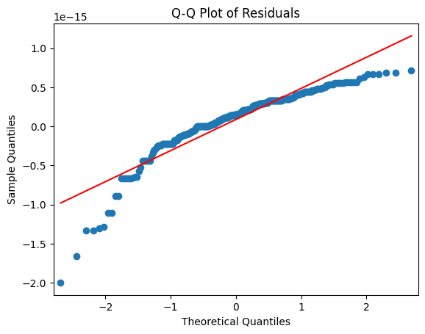
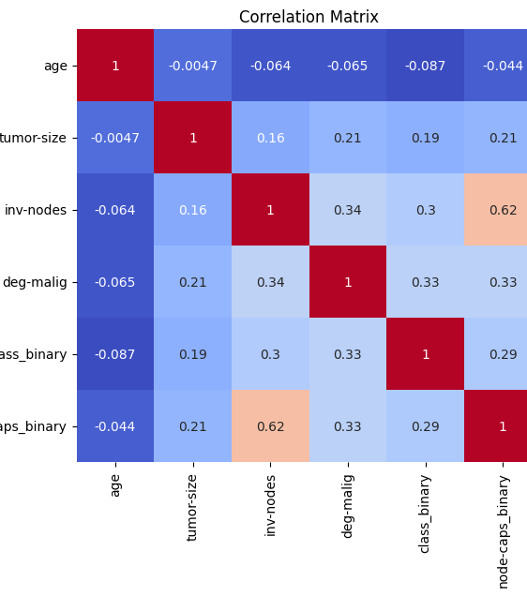
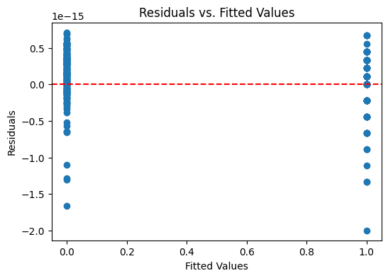
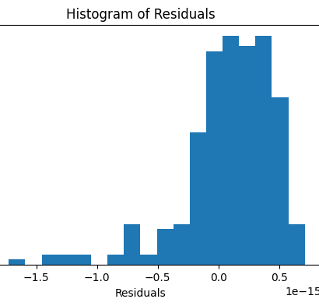
Assumption Check

Slide 6
Linear Regression Results
Iterations – All Variables, Numerical Only, Optimized
Observations (Linear Regression):
when all variables are included, the R^2 drops drastically to ~0.00077, meaning the predictors collectively explain almost none of the variance in the target
Some important variables in the 3-variable model lose their predictive power when combined with others (interactions, nonlinear effects)
Results
Mean Squared Error: 5.110049302325527 e-31 ; R-squared: 1.0

Slide 7
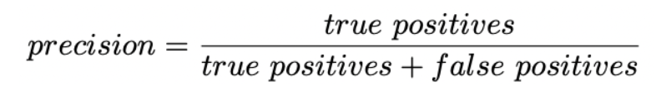

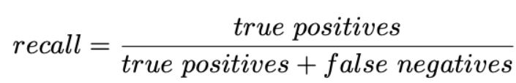
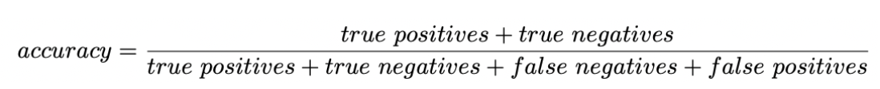
Machine Learning Evaluators

Slide 8
XGBoost
Assumptions:
XGBoost may assume that encoded integer values for each input variable have an ordinal relationship
XGBoost assume that your data may not be complete (i.e. it can deal with missing values)
Categorical variables must be transformed into numeric variables because XGBoost only manages numeric vectors

Slide 9
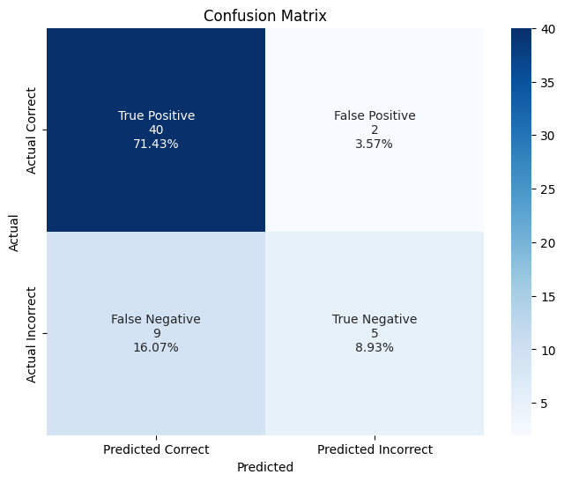
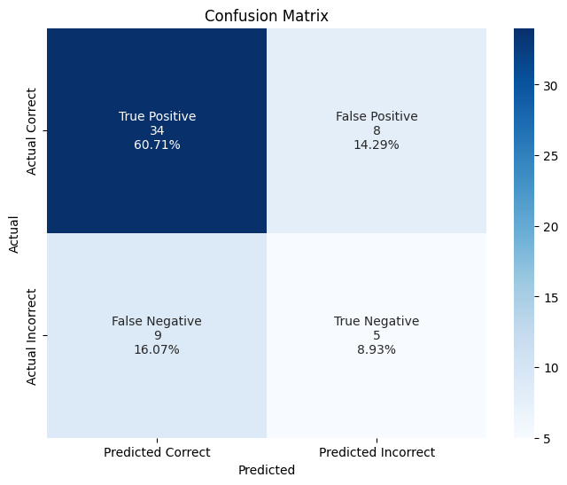
XGBoost Results
XGBoost
XGBoost w/ SMOTE
Accuracy: 0.8035714285714286
Precision: 0.7142857142857143
Recall: 0.35714285714285715
F1 Score: 0.4761904761904762
Accuracy: 0.6964285714285714
Precision: 0.38461538461538464
Recall: 0.35714285714285715
F1 Score: 0.3703703703703704

Slide 10
XGBoost Conclusions
SMOTE did not yield any visible improvements to model performance
Accuracy (0.80 or 80.4%) The model correctly classifies 80.4% of all instances in the dataset. However, accuracy alone can be misleading, especially since the dataset is imbalanced (the no cancer recurrence appears much more than the other).
Precision (0.714 or 71.4%) Precision = TP / (TP + FP) (true positives divided by all predicted positives). 71.4% precision means that when the model predicts the positive class, it is correct 71.4% of the time. A relatively low precision suggests many false positives (incorrectly classifying negatives as positives).
Recall (0.357 or 35.7%) Recall = TP / (TP + FN) (true positives divided by all actual positives). 35.7% recall means the model only identifies 35.7% of actual positive cases, missing a significant portion. A low recall indicates the model has many false negatives (failing to detect positives).
F1 Score (0.476 or 47.6%) The F1 score is the harmonic mean of precision and recall, balancing both. A low F1 score (47.6%) suggests the model is not performing well at detecting the positive class.

Slide 11
Random Forest Assumptions
Each tree makes its own decisions: Every tree in the forest makes its own predictions without relying on others
Random parts of the data are used: Each tree is built using random samples and features to reduce mistakes
Enough data is needed: Sufficient data ensures the trees are different and learn unique patterns and variety
Different predictions improve accuracy: Combining the predictions from different trees leads to a more accurate final results

Slide 12
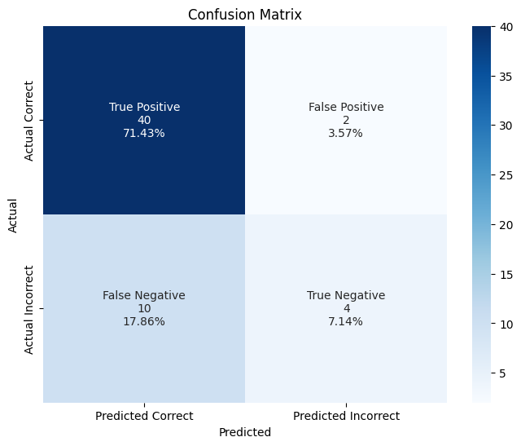
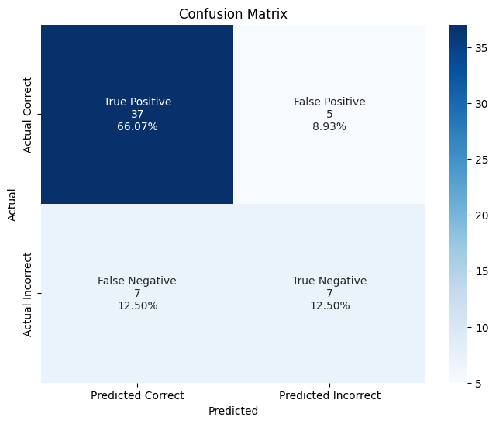
Random Forest Results
Random Forest
Random Forest w/ SMOTE
Accuracy: 0.7857142857142857
Precision: 0.6666666666666666
Recall: 0.2857142857142857
F1 Score: 0.4
Accuracy: 0.7857142857142857
Precision: 0.5833333333333334
Recall: 0.5
F1 Score: 0.5384615384615384

Slide 13
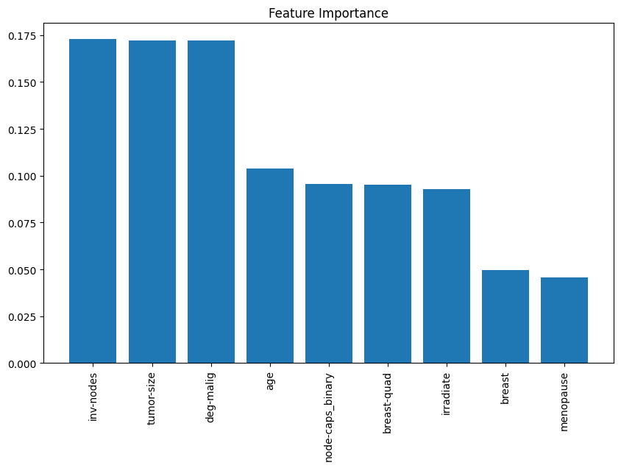
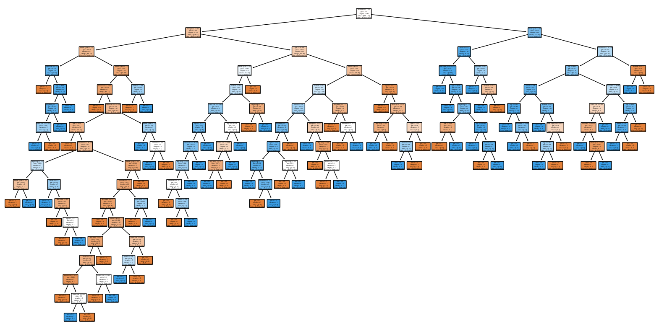
Random Forest Conclusions

Slide 14
Random Forest Conclusions
Observations (Random Forest):
SMOTE yields an improvement in recall and the F1 score but still could potentially be improved
Accuracy (0.785 or 78.5%) The model correctly classifies 78.5% of all instances in the dataset. However, accuracy alone can be misleading, especially since the dataset is imbalanced (the no cancer recurrence appears much more than the other).
Precision (0.666 or 66.6%) Precision = TP / (TP + FP) (true positives divided by all predicted positives). 66.6% precision means that when the model predicts the positive class, it is correct 66.6% of the time. A relatively low precision suggests many false positives (incorrectly classifying negatives as positives).
Recall (0.286 or 28.6%) Recall = TP / (TP + FN) (true positives divided by all actual positives). 28.6% recall means the model only identifies 28.6% of actual positive cases, missing a significant portion. A low recall indicates the model has many false negatives (failing to detect positives).
F1 Score (0.4 or 40%) The F1 score is the harmonic mean of precision and recall, balancing both. A low F1 score (40%) suggests the model is not performing well at detecting the positive class.
Cross-validation scores:
Individual fold accuracies: 73.21%, 75%, 69.09%, 72.73%, 70.91% Scores vary slightly, indicating stable performance across folds. Average cross-validation score: 72.19%
Shows consistent model performance on different data subsets. Slightly lower than the test accuracy (78.57%), indicating potential overfitting. Test accuracy: 78.57%
Higher than the cross-validation average, suggesting some overfitting to the training data.

Slide 15
Support Vector Machine (SVM) Assumptions
Assumptions:
It assumes data is independent and identically distributed

Slide 16

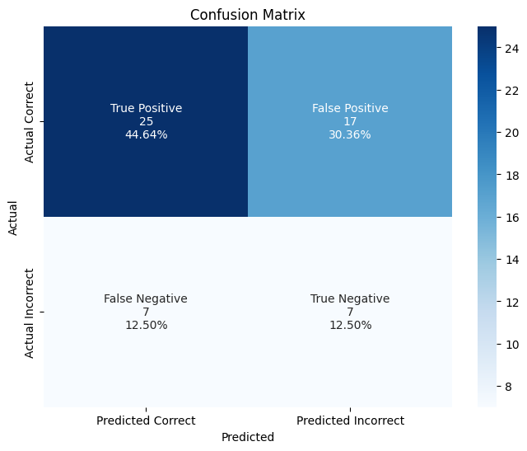
SVM Results
SVM
SVM w/ SMOTE
Accuracy: 0.6785714285714286
Precision: 0.375
Recall: 0.42857142857142855
F1 Score: 0.39999999999999997
Accuracy: 0.5714285714285714
Precision: 0.2916666666666667
Recall: 0.5
F1 Score: 0.3684210526315789

Slide 17
Conclusion
Among the three models evaluated (XGBoost, Random Forest, and SVM), XGBoost demonstrated the best overall performance in terms of accuracy (80.4%) and precision (71.4%). However, all models struggled with recall, indicating difficulty in correctly identifying actual cancer recurrence cases.
XGBoost achieved the highest precision (71.4%) but had a low recall (35.7%), suggesting that while its positive predictions were relatively reliable, it missed a significant number of actual recurrence cases. The F1-score (47.6%) highlights this trade-off.
Random Forest performed slightly worse in terms of accuracy (78.5%) and precision (66.6%) and had the lowest recall (28.6%), leading to an F1-score of 40%. Cross-validation results indicate some overfitting, with test accuracy (78.57%) exceeding the cross-validation average (72.19%).
SVM had the lowest accuracy (67.9%), precision (37.5%), and F1-score (40%), but its recall (42.9%) was slightly better than the other models. This suggests it was somewhat better at identifying actual positive cases but generated too many false positives.

Slide 18
Key Takeaways
No model performed exceptionally well in recall, which is crucial for detecting cancer recurrence. A high number of false negatives could have severe consequences in a clinical setting.
XGBoost was the best-performing model overall, balancing accuracy and precision, though it still struggled with recall.
Random Forest showed some signs of overfitting, as indicated by the difference between cross-validation and test accuracy.
SVM had the weakest performance across all metrics, making it the least favorable model for this task.

Slide 19
References
Blows, F. M., Driver, K. E., Schmidt, M. K., et al. (2010). Subtyping of breast cancer by immunohistochemistry to investigate a relationship between subtype and short and long term survival: a collaborative analysis of data for 10,159 cases from 12 studies. PLoS medicine, 7(5), e1000279.
Early Breast Cancer Trialists' Collaborative Group (EBCTCG). (2021). Long-term outcomes after radiotherapy or surgery for early-stage breast cancer. The Lancet Oncology.
Gao, Z., Zhang, Y., Styblo, T. M., et al. (2022). Machine learning applications in predicting breast cancer recurrence and treatment response. Cancer Informatics, 21, 117693512211073.
Lichman, M.: UCI machine learning repository, University of California, School of Information and Computer Science, Irvine, CA (2019). http://archive.ics.uci.edu/ml/datasets/breast+cancer
Yasaka, K., Akai, H., Kunimatsu, A., et al. (2018). Deep learning with convolutional neural network for differentiation of liver masses at dynamic contrast- enhanced CT: a preliminary study. Radiology, 286(3), 887-896.
Zhang, X., Yang, P., & Xu, Z. (2020). Applications of machine learning in breast cancer diagnosis and prognosis. Cancer Biology & Medicine, 17(4), 943.

